Slide 1
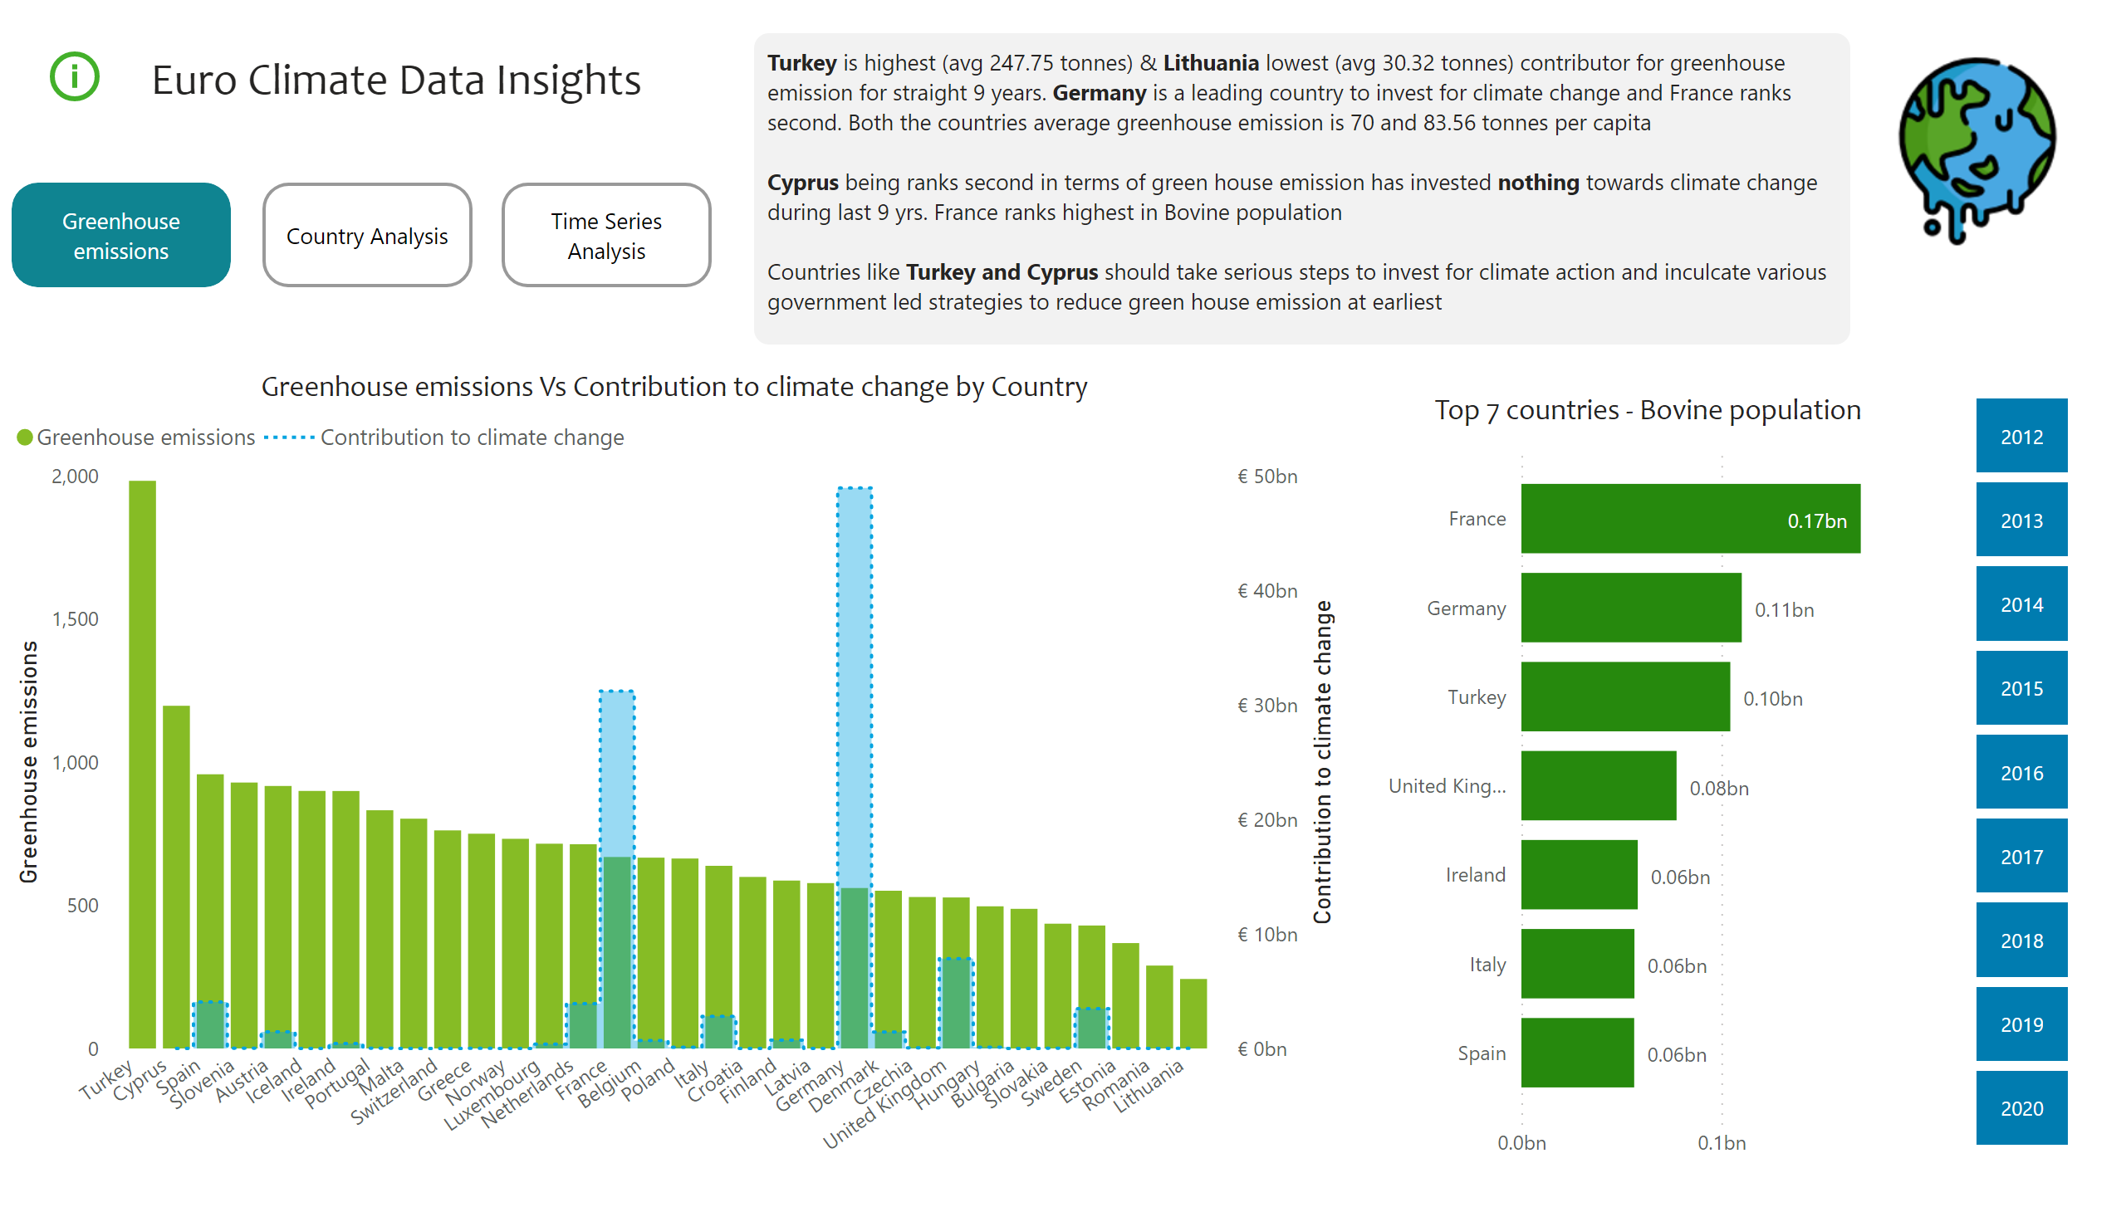
First Page
Notes:
actionButton
No alt text provided
Greenhouse emissions Vs Contribution to climate change by Country
No alt text provided
actionButton
No alt text provided
textbox
No alt text provided
image
No alt text provided
actionButton
No alt text provided
textbox
No alt text provided
Top 7 countries - Bovine population
No alt text provided
slicer
No alt text provided
actionButton
No alt text provided

Slide 2
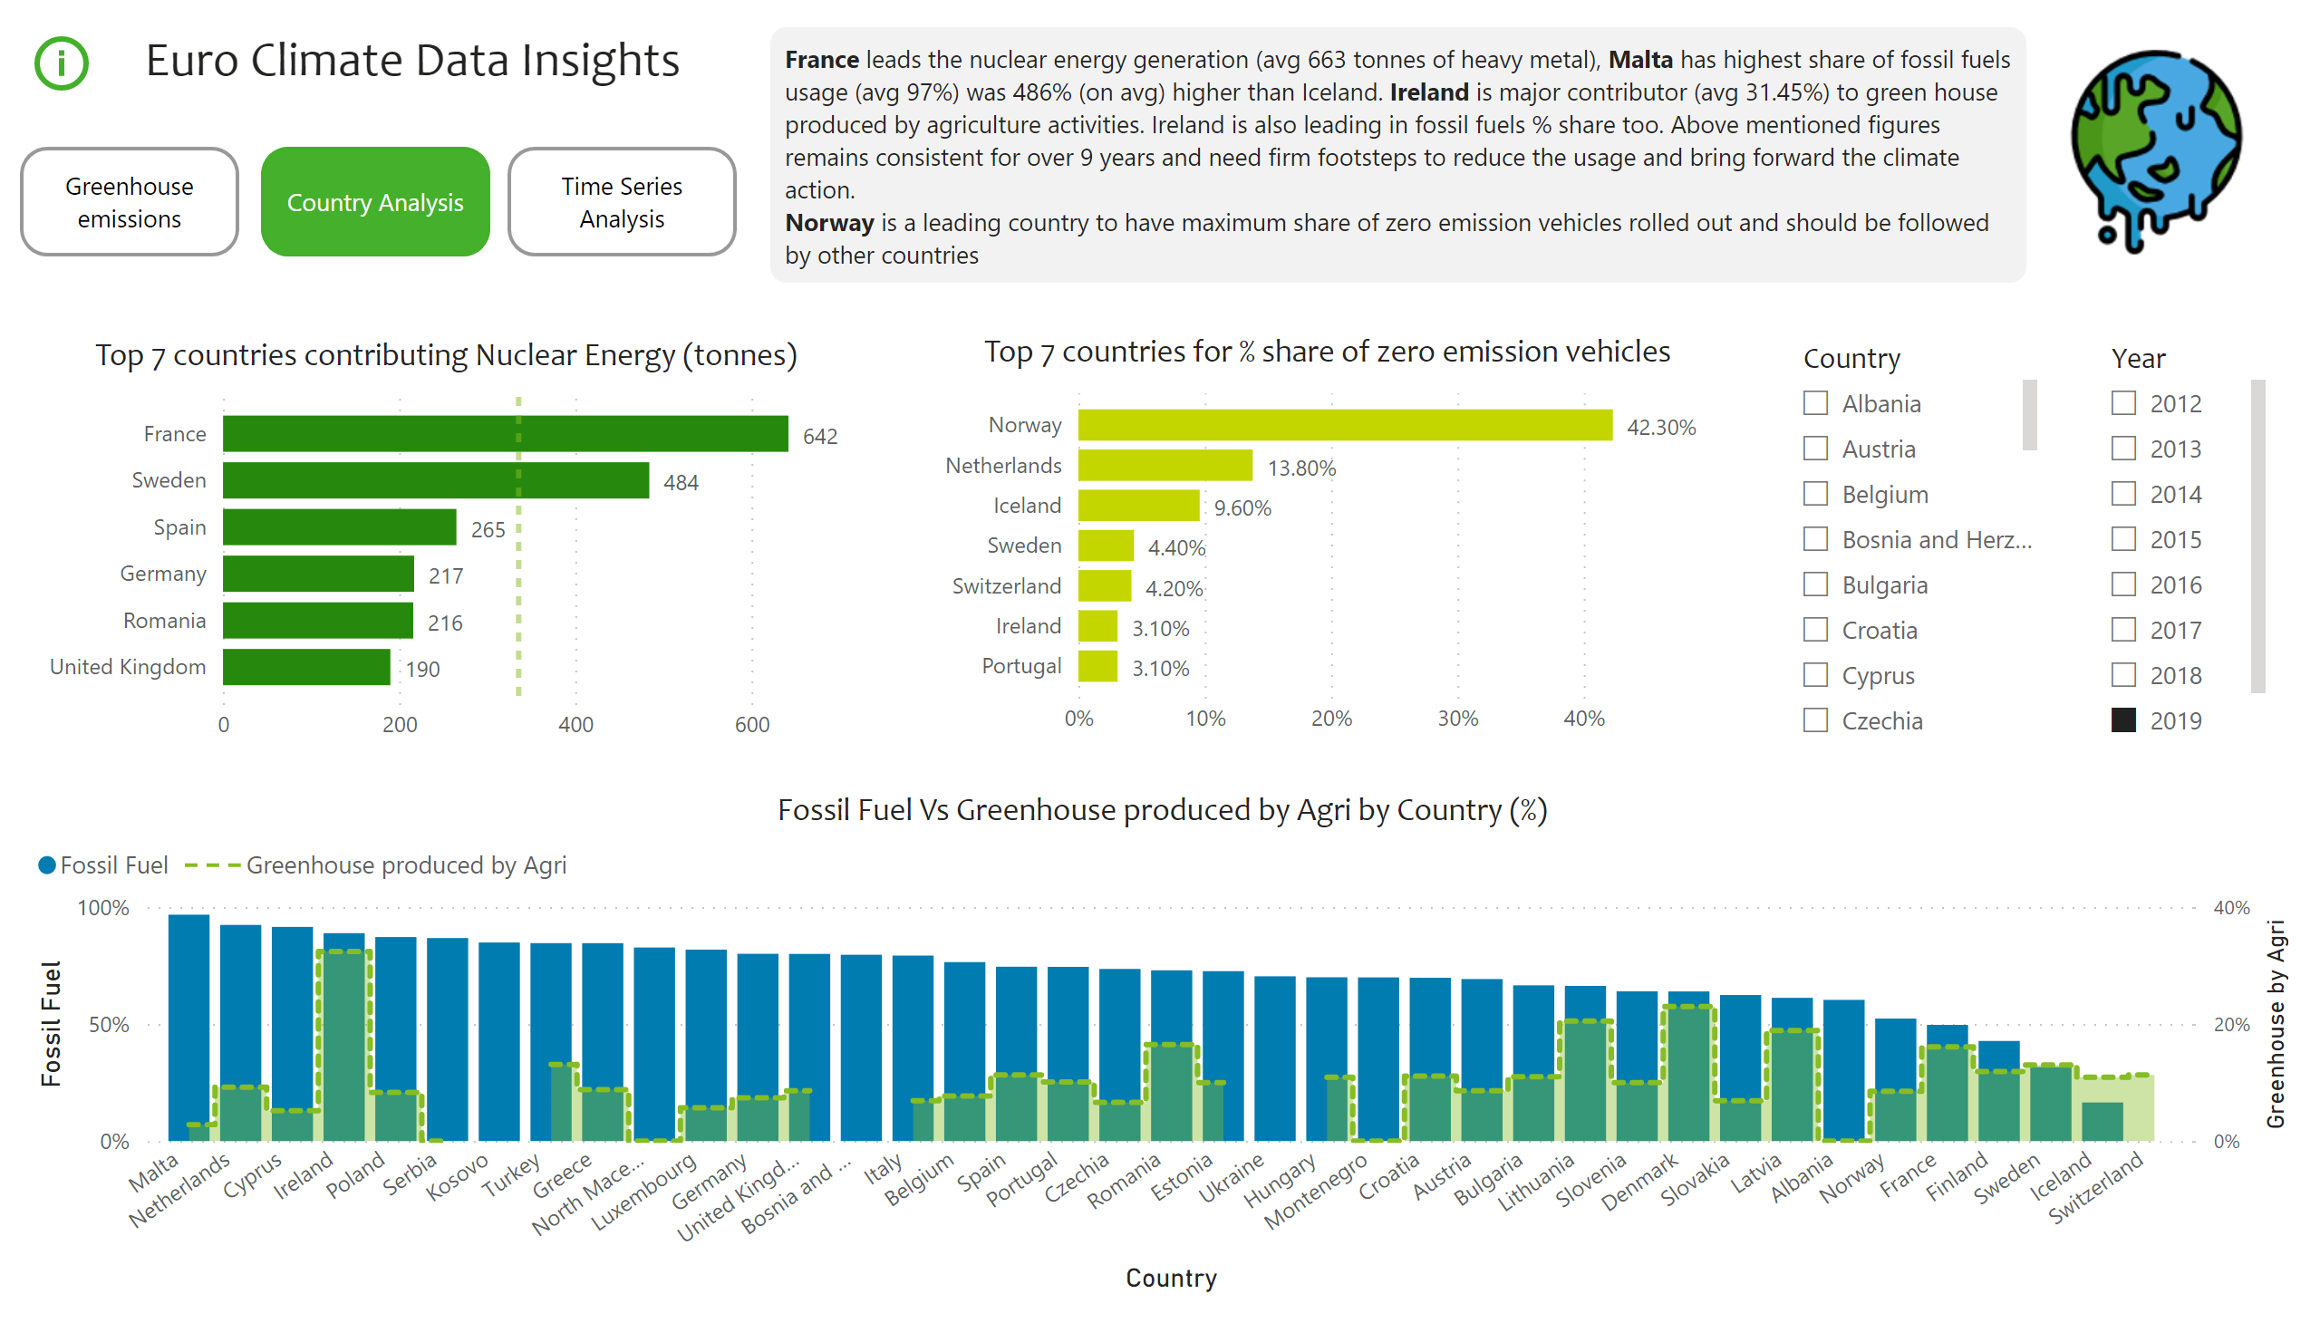
Second Page
Notes:
textbox
No alt text provided
Fossil Fuel Vs Greenhouse produced by Agri by Country (%)
No alt text provided
slicer
No alt text provided
Top 7 countries contributing Nuclear Energy (tonnes)
No alt text provided
Top 7 countries for % share of zero emission vehicles
No alt text provided
image
No alt text provided
actionButton
No alt text provided
slicer
No alt text provided
textbox
No alt text provided
actionButton
No alt text provided
actionButton
No alt text provided
actionButton
No alt text provided

Slide 3
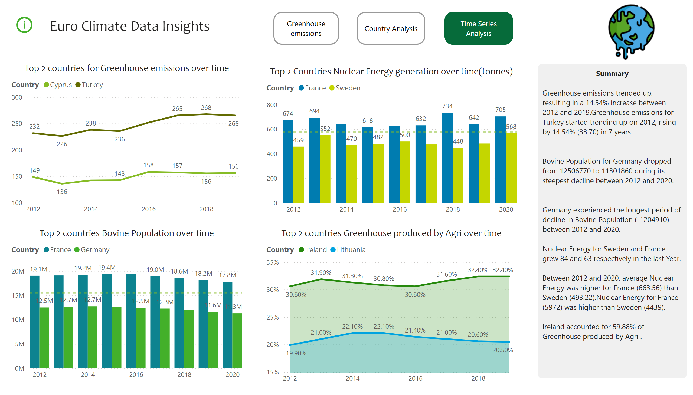
Third Page
Notes:
Top 2 countries for Greenhouse emissions over time
No alt text provided
Top 2 countries Bovine Population over time
No alt text provided
Top 2 Countries Nuclear Energy generation over time(tonnes)
No alt text provided
Top 2 countries Greenhouse produced by Agri over time
No alt text provided
textbox
No alt text provided
textbox
No alt text provided
image
No alt text provided
actionButton
No alt text provided
actionButton
No alt text provided
actionButton
No alt text provided
actionButton
No alt text provided

